Slide 1
RAILWAY RESERVATION SYSTEM

Slide 2
agenda
Introduction
Objective
System Architecture
Program Snippet
Database Management
Conclusion

Slide 3

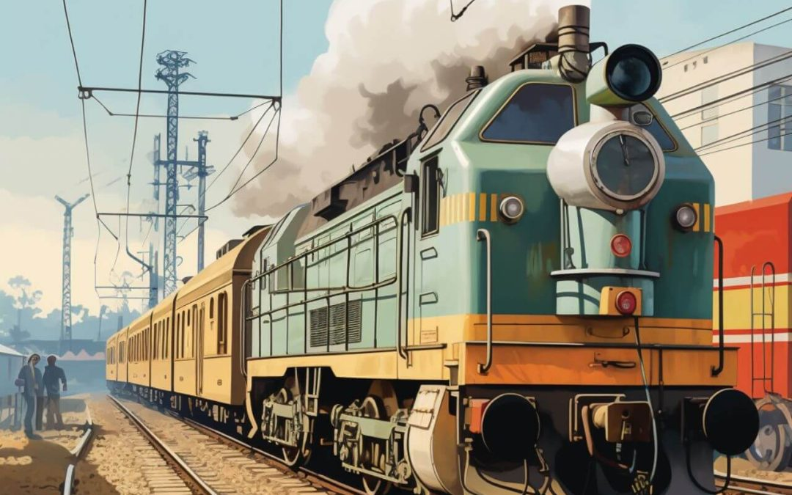
Introduction A railway reservation system is a critical component of modern railway operations.

Slide 4
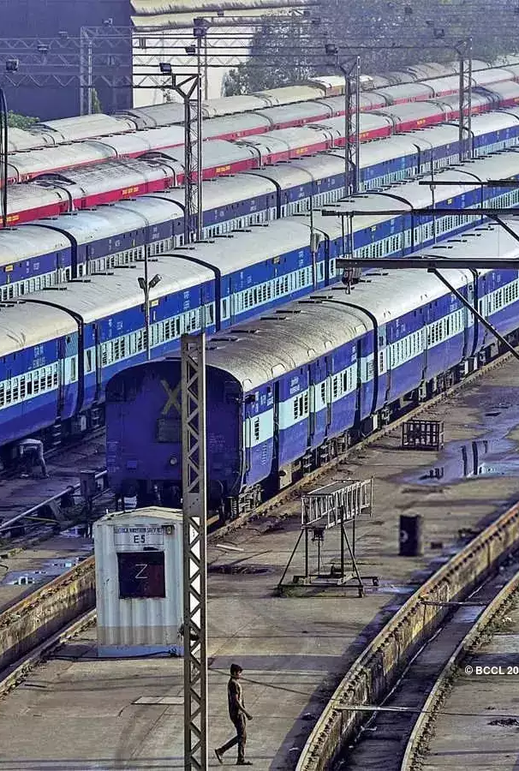
objective
Automate Reservation Process
Develop a user-friendly interface for booking, canceling, and modifying train tickets.
Ensure the system supports both online and offline bookings to cater to all user needs.
Secure Payment Processing
Integrate a secure payment gateway to handle transactions safely and efficiently.
Ensure compliance with payment security standards (e.g., PCI DSS) to protect user data

Slide 5
Database Management and Security
Design a robust database structure to store and manage reservation data efficiently.
Implement advanced security measures to protect against data breaches and unauthorized access.
Data Analytics and Reporting
Enable data collection and analytics to provide insights into booking patterns, peak times, and user preferences.
Develop reporting tools to assist railway authorities in decision-making and strategic planning.
Scalability and Performance
Ensure the system can handle high volumes of transactions during peak periods without performance degradation.
Design the architecture to be scalable, allowing easy upgrades and expansions as needed.

Slide 6
SYSTEM ARCHITECTURE
Components of the System Architecture
Presentation Layer
User Interface (UI):
Web and Mobile Applications: User-friendly interfaces for passengers to book, cancel, and modify reservations.
Admin Portal: Interfaces for railway staff to manage schedules, view reports, and handle customer support.
Application Layer
Business Logic:
Reservation Management: Handles booking, cancellation, and modification logic.
Schedule Management: Manages train schedules, availability, and route planning.
Payment Processing: Integrates with payment gateways to process transactions securely.

Slide 7
3.Data Access Layer
Database Management:
Relational Databases: Store structured data (e.g., user information, reservations, schedules).
NoSQL Databases: Handle unstructured data and support high availability (e.g., logs, real-time analytics).
4.Security Layer
Authentication and Authorization:
User Authentication: Ensure secure login using mechanisms like OAuth, JWT.
Role-Based Access Control: Manage permissions based on user roles.
Data Encryption:
Encrypt sensitive data both in transit and at rest to protect user information.
Firewall and Intrusion Detection:
Protect the system from unauthorized access and cyber threats

Slide 8
Program snippet
import java.util.ArrayList;
import java.util.Scanner;
class Train {
private int id;
private String name;
private int totalSeats;
private int availableSeats;
public Train(int id, String name, int totalSeats){
this.id = id;
this.name = name;
this.totalSeats = totalSeats;
this.availableSeats = totalSeats;
}
public int getId() {
return id;
} public String getName()
{
return name; }
public int getAvailableSeats()
{
return availableSeats;
} public boolean bookSeat()
{ if (availableSeats > 0)
{ availableSeats--; return true;
} else
{ return false;
} }

Slide 9

public boolean
cancelSeat()
{
if (availableSeats < totalSeats)
{ availableSeats++;
return true;
} else
{ return false;
} } }
class RailwayReservationSystem
{ private ArrayList<Train> trains;
publicRailwayReservationSystem() { trains = new ArrayList<>();
// Initialize with some trains
trains.add(new Train(1, "Express A", 100));
trains.add(new Train(2, "Express B", 150));
trains.add(new Train(3, "Express C", 200)); }
public void displayTrains()
public void displayTrains()
{ System.out.println("Train List:");
for (Train train : trains) {
System.out.println("ID: " + train.getId() + ", Name: " + train.getName() + ", Available Seats: " + train.getAvailableSeats());
} } public boolean bookTicket(int trainId) {
for (Train train : trains) {
if (train.getId() == trainId)
{ return train.bookSeat();
} } return false; }
public boolean cancelTicket(int trainId)
{ for (Train train : trains)
{ if (train.getId() == trainId
) { return train.cancelSeat();
} } return false;
}

Slide 10
public static void main(String[] args)
{ RailwayReservationSystem system = new RailwayReservationSystem(); Scanner scanner = new Scanner(System.in);
while (true)
{ System.out.println("\nRailway Reservation System");
System.out.println("1. Display Trains"); System.out.println("2. Book Ticket"); System.out.println("3. Cancel Ticket"); System.out.println("4. Exit"); System.out.print("Enter your choice: "); int choice = scanner.nextInt();
switch (choice) {
case 1: system.displayTrains();
break;
case 2: System.out.print("Enter Train ID to book: ");
int trainIdToBook = scanner.nextInt();
if (system.bookTicket(trainIdToBook)) { System.out.println("Ticket booked successfully.");
}
Else
{ System.out.println("Failed to book ticket. No available seats or invalid train ID.");
}
break;

Slide 11
case 3: System.out.print("Enter Train ID to cancel: ");
int trainIdToCancel = scanner.nextInt();
if (system.cancelTicket(trainIdToCancel))
{ System.out.println("Ticket canceled successfully.");
} else
{ System.out.println("Failed to cancel ticket. Invalid train ID.");
} break;
case 4: System.out.println("Exiting system. Goodbye!");
scanner.close();
return;
default:
System.out.println("Invalid choice. Please try again.");
break;
}
}
}
}

Slide 12
Program explanation
1.Train Class
:id: Unique identifier for the train
.name: Name of the train
.totalSeats: Total number of seats in the train.
availableSeats: Number of available seats.
Methods for booking and canceling seats.
2.RailwayReservationSystem Class:
trains: List of trains available in the system.
Methods for displaying trains, booking tickets, and canceling tickets.
3.Main Method:Provides a command-line interface for the user to interact with the system
Options for displaying trains, booking tickets, canceling tickets, and exiting the system.
This simple implementation demonstrates the basic functionality of a railway reservation system. You can expand this by adding more features such as user authentication, payment processing, and more detailed train schedules.

Slide 13
Database management
To add database management to the railway reservation system, we need to integrate a database for storing train and reservation information.
We'll use MySQL as the database for this example.
You can follow these steps to set up database management in the Java project:
Setup MySQL Database:
Install MySQL on your system.
Create a database called railway_reservation.
Create tables for train and reservation.Configure Database Connection in Java:
Add MySQL JDBC driver dependency to your project.
Create a database connection class.
Update Classes to Interact with the Database:
Update the Train and RailwayReservationSystem classes to interact with the database.

Slide 14
conclusion
User Interaction:
The command-line interface provides a straightforward way for users to interact with the system. It handles user inputs for various operations such as displaying trains, booking tickets, and canceling reservations.
Error Handling:
The system includes basic error handling to manage invalid inputs and database connection issues, ensuring robustness and a better user experience.
The Java project for the management of a railway reservation system demonstrates the essential aspects of designing and implementing a practical, database-driven application. This project covers several fundamental concepts and technologies, including object-oriented programming, database connectivity, and user interaction via a command-line interface.
Key Highlights:
Object-Oriented Design:
The project employs a modular approach by creating distinct classes (Train, DatabaseConnection, and RailwayReservationSystem) to handle different aspects of the system. This enhances maintainability and scalability.
Database Integration:
Integration with MySQL allows for persistent data storage, ensuring that train and reservation information is reliably saved and retrieved. This step involves setting up tables, connecting to the database, and performing CRUD operations.

Slide 15
Thank you

